Slide 1
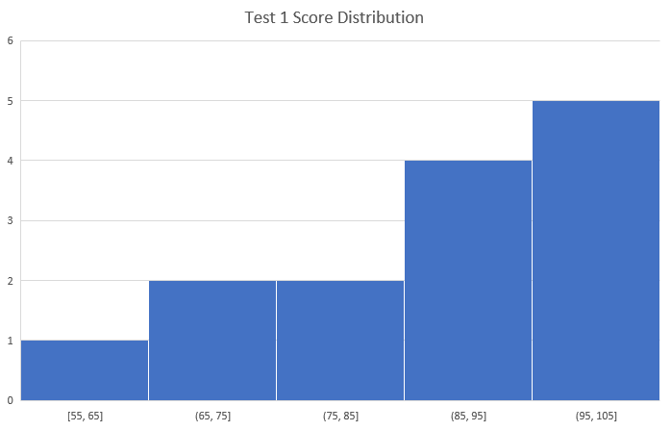
Chapter 1 Test Statistics
Max: 100
Min: 55
Average: 86
Median: 90

Slide 2
Useful Websites
Github
https://github.com/topics
Google Scholar
https://scholar.google.com/

Slide 3
Unit 2: The Internet
Introducing the internet
Connecting networks
Addressing the internet
Routing with redundancy
Transporting packets
Web protocol
Scalable System
The internet protocol suite
Open protocol development

Slide 4
Unit 2: The Internet
Introducing the internet

Slide 5

Notes:
https://www.youtube.com/watch?v=x3c1ih2NJEg

Slide 6
Introducing the internet
Protocols: A set of rules that define how each device must communicate with each other on the internet
To create a global network of computing devices, we need:
Wires & wireless: Physical connections between devices, plus protocols for converting electromagnetic signals into binary data
IP: A protocol that uniquely identify devices using IP addresses and provides a routing strategy to send data to a destination IP address
TCP/UDP: Protocols that can transport packets of data from one device to another and check for errors along the way
TLS: A secure protocol for sending encrypted data so that attackers can't view private information
HTTP & DNS: The protocols powering the World Wide Web, what the browser uses every time you load a webpage

Slide 7
Unit 2: The Internet
Introducing the internet
Computer networks

Slide 8

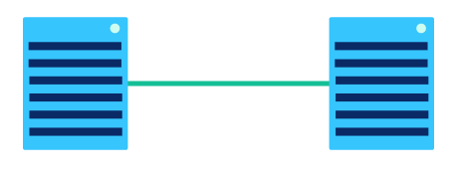
Computer Networks
A computer network is any group of interconnected computing devices capable of sending or receiving data
A computing device is any device that can run a program, such as a tablet, phone, or smart sensor.

Slide 9
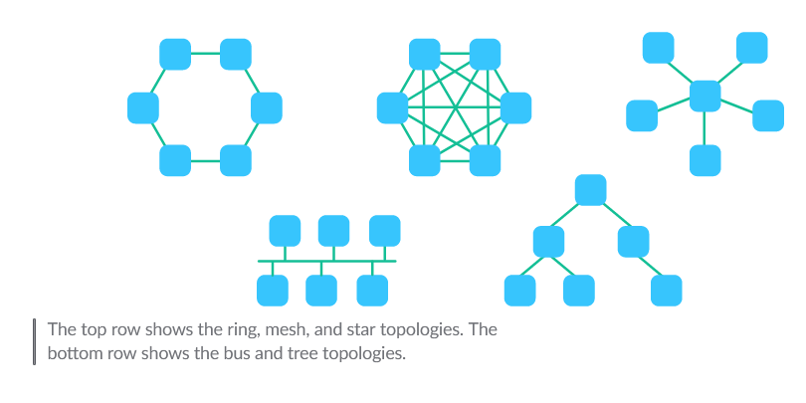
Network topology

Slide 10
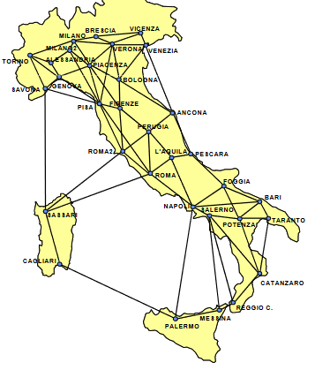
Research in Computer Science: Graph theory
* Optional
What general topology should the mobile network design be like? Star, Ring, mesh and why?
Where should we place the cell towers such that we minimize the cost? Should we take population density into consideration?
If one cell tower fails, how do we ensure that people nearby still have reach to another cell tower not so far away?

Slide 11
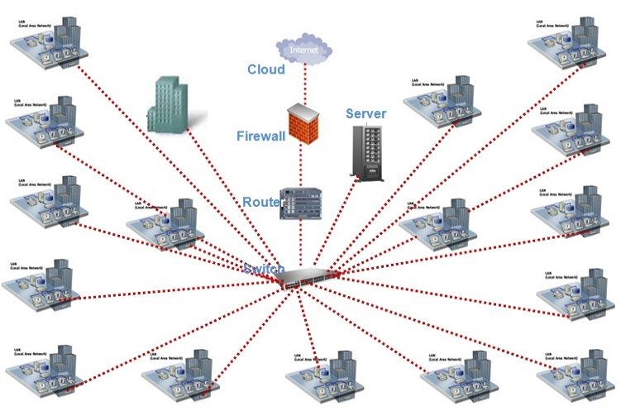
Local Area Network (LAN)
Local area network (LAN), a network that covers a limited area like a house or school.

Slide 12

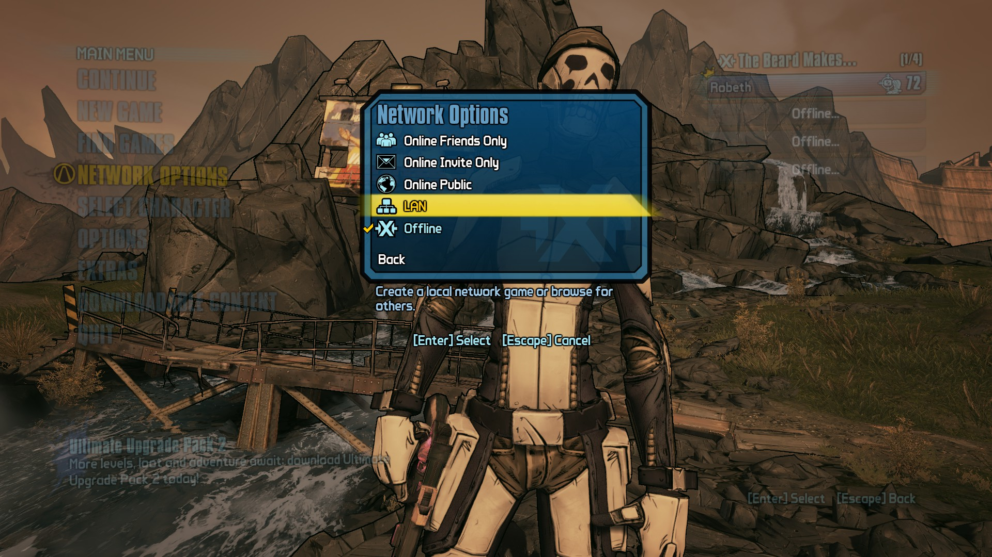
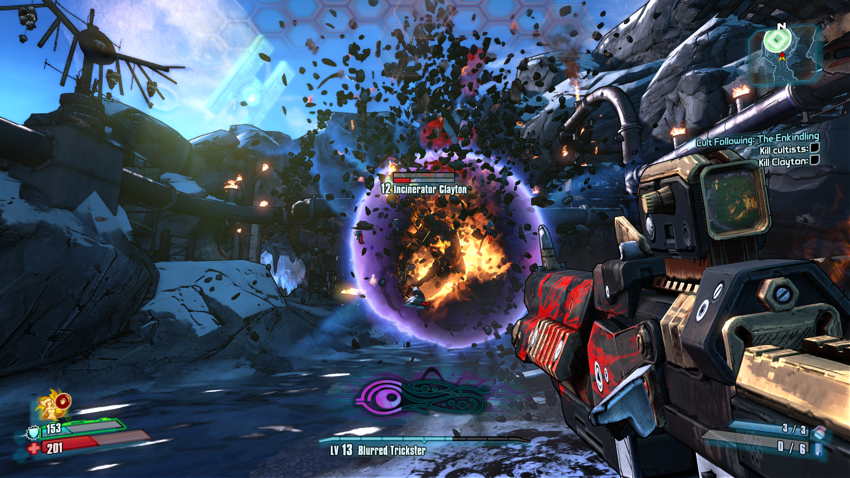
Example of LAN – Local area gaming

Slide 13
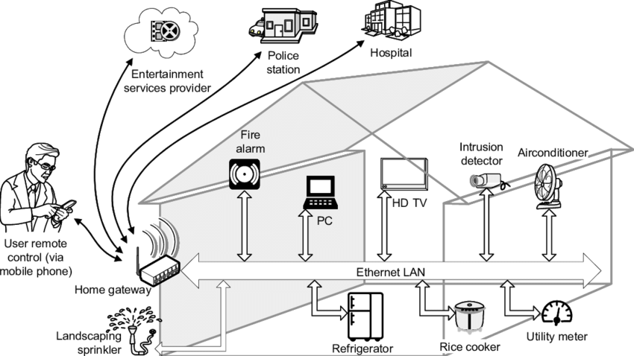
Example of LAN – Smart homes
Chen, Beizhong & Kamel, I. & Marsic, Ivan. (2010). Memory Management in Smart Home Gateway. 10.5772/8406.

Slide 14
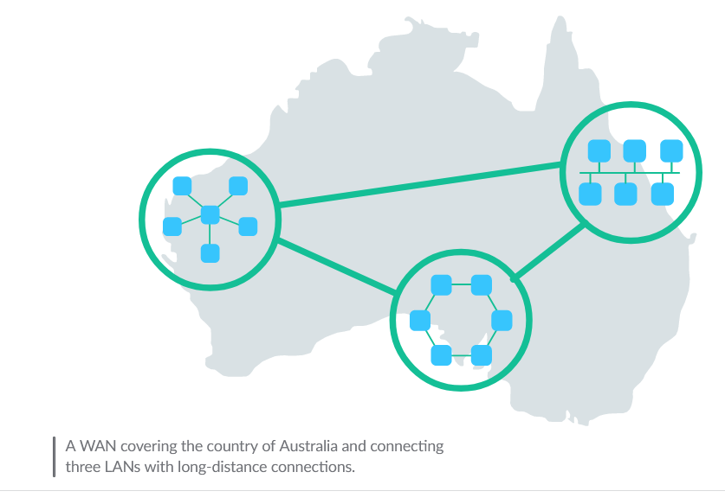
Wide Area Network (WAN)
Wide Area Network (WAN), a network that extends over a large geographic area and is composed of many, many LANs.

Slide 15
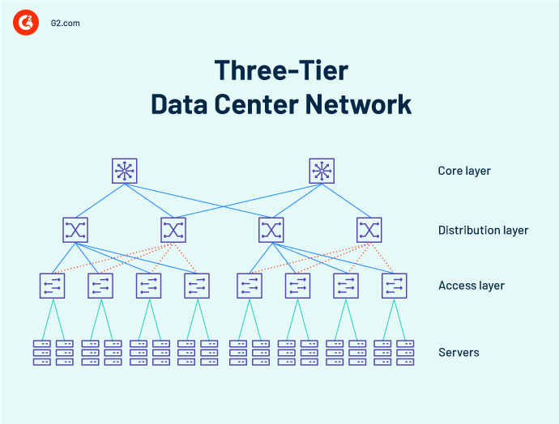
Data Center Networks (DCN)
Data Center Network (DCN), a network used in data centers where data must be exchanged with very little delay.

Slide 16
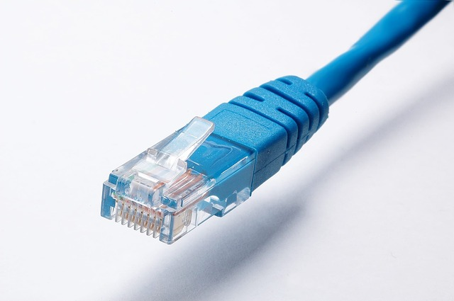
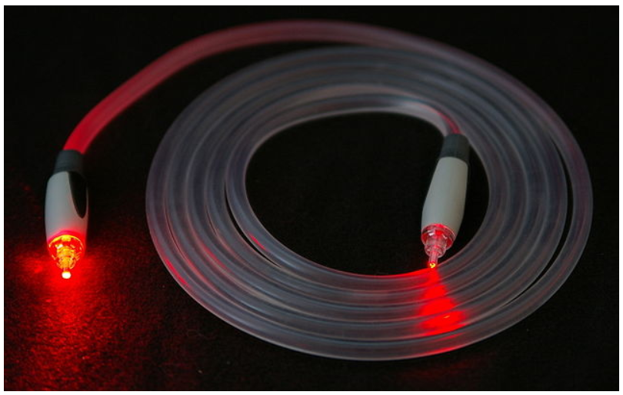
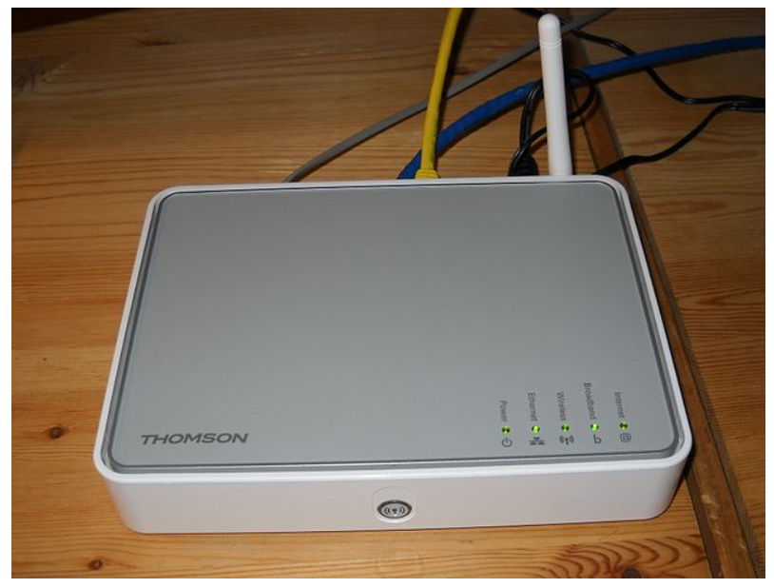
Physical Network Connection
Copper Cables
Fiber-optic cables
Wireless

Slide 17
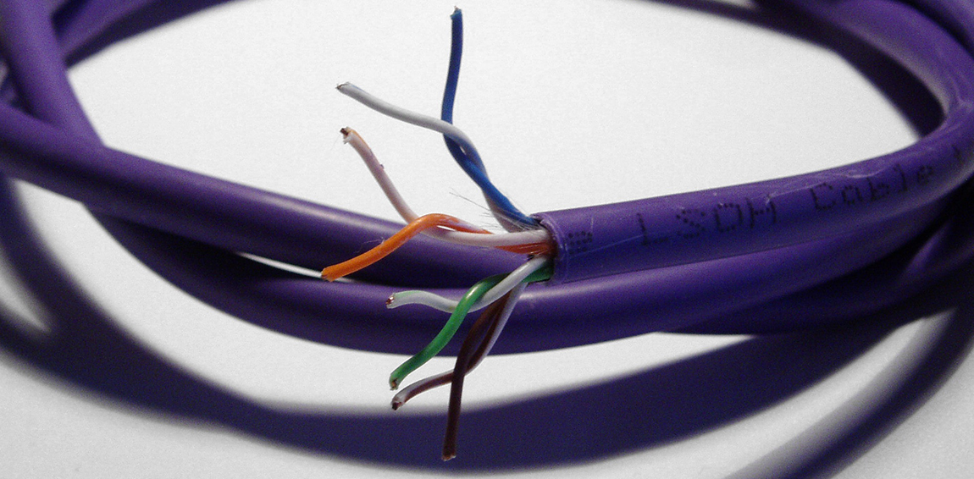
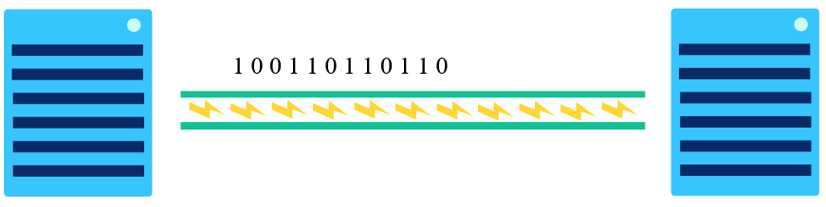
Copper cables
Copper cables are twisted pair cables (Ethernet cables) that transmits data through pulses of electricity.
CAT 5

Slide 18
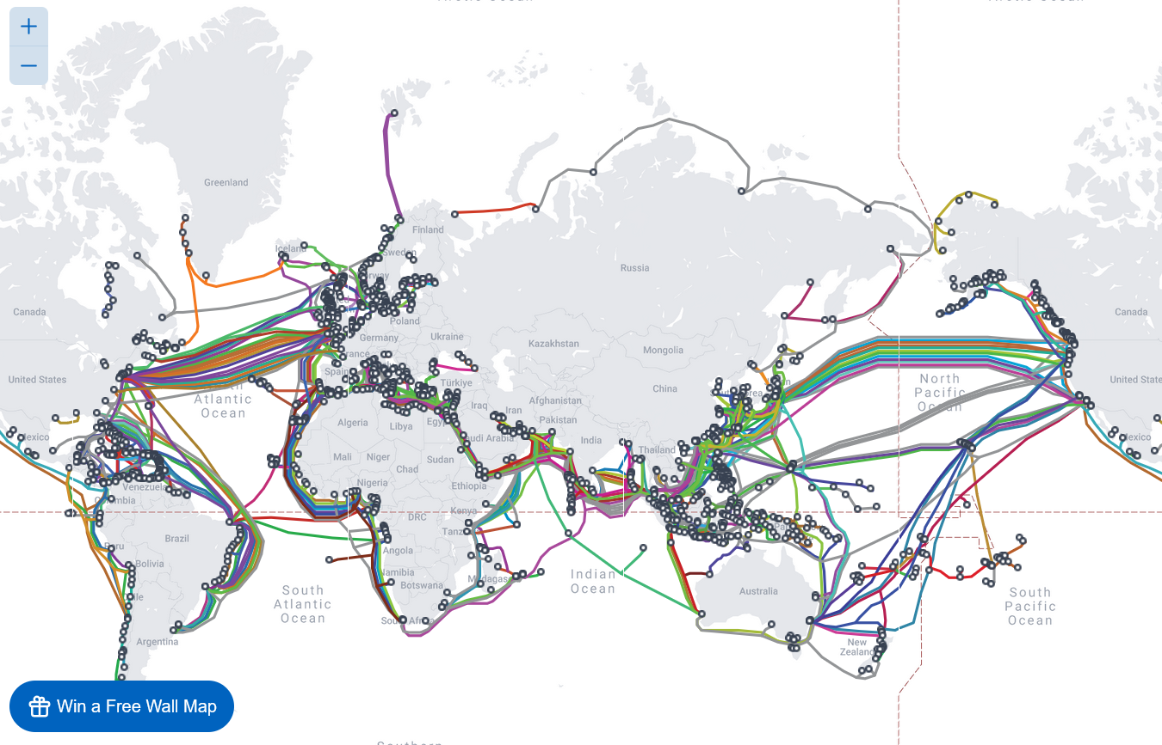
Fiber-optic cables
A fiber-optic cable contains an optical fiber that can carry light. Fiber-optic cables communicate by sending pulses of light that represent binary data.
Notes:
https://www.submarinecablemap.com/

Slide 19
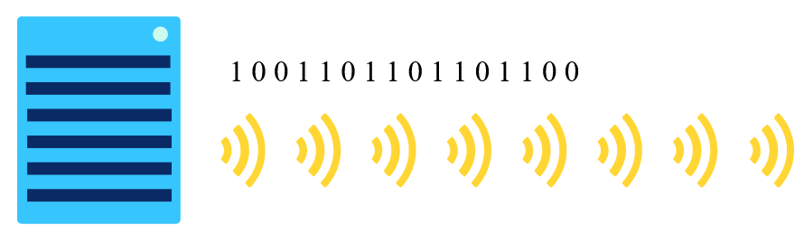
Wireless
A wireless card inside the computer turns binary data into radio waves and transmits them through the air

Slide 20
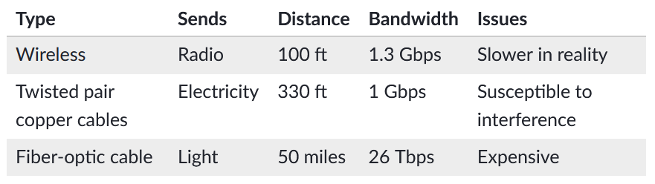
Comparison between different network connections

Slide 21
Review
Definition of Computer network & computing device
Network Topology
LAN
WAN
Physical Connections:
Copper cable
Fiber-optic cable
Wireless

Slide 22
Bit rate, bandwidth, and latency

Slide 23
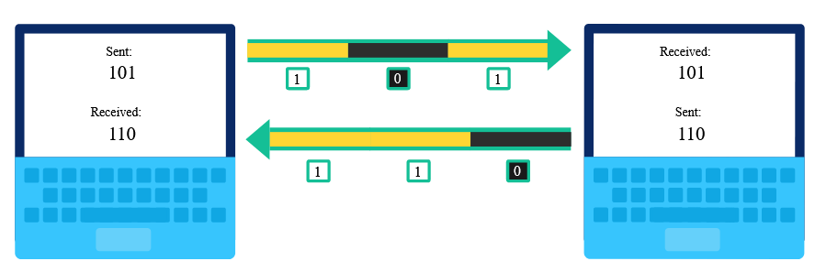
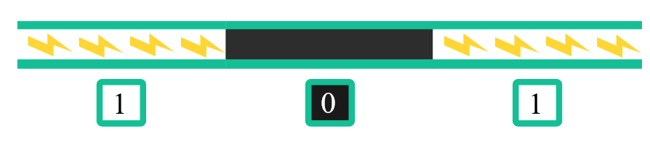
Sending streams of 0s and 1s
Computers use line coding to send data
Line coding: The process of converting digital data into time-based signals
Ex: sending 101 to another device

Slide 24
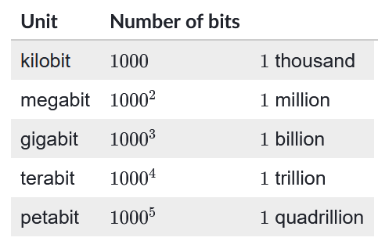
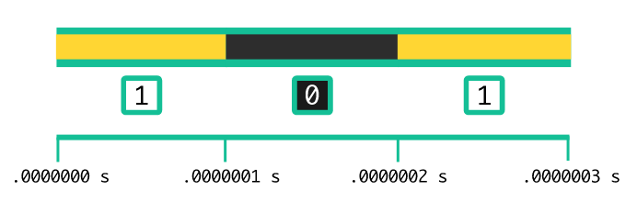
Bit rate
Bit rate: Bit rate is a measurement of the speed of the network, that is the number of bits that can are sent every second.

Slide 25
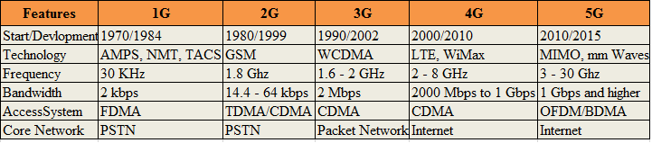
Bandwidth
Bandwidth: The maximum bit rate of a system

Slide 26
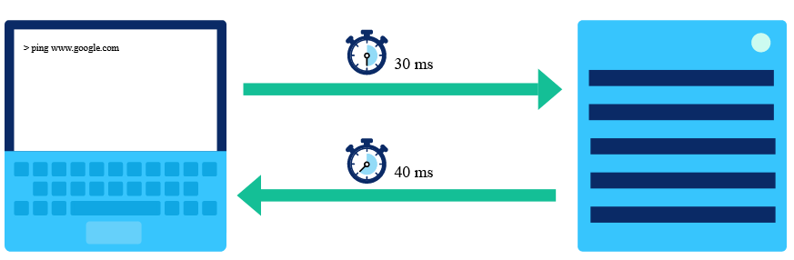
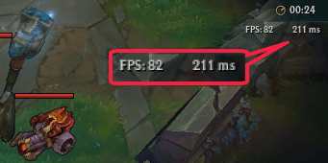
Latency
Latency: Latency is another measure of the speed of a network. It is the time between the sending of a data message and the receiving of that message, measured in milliseconds. The round-trip time is also called Ping

Slide 27
Is it possible to have a high bandwidth, but a low bit rate? What scenarios can you think of? And What would the latency be? (High | Low)

Slide 28
Unit 2: The Internet
Introducing the internet
Computer networks
Addressing the internet

Slide 29
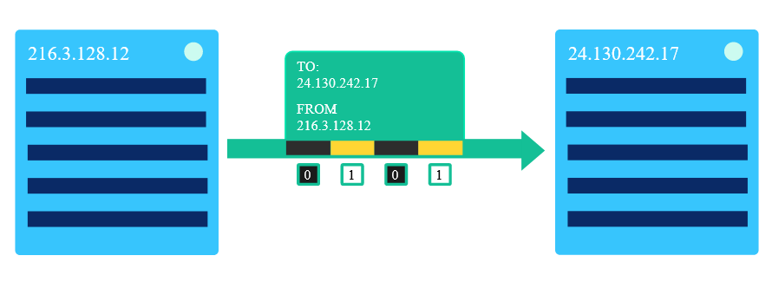
Addressing the Internet
Internet Protocol (IP): IP is a protocol, or set of rules, for routing and addressing packets of data so that they can travel across networks and arrive at the correct destination
IP addresses: An IP address is a unique address that identifies a device on the internet or a local network

Slide 30
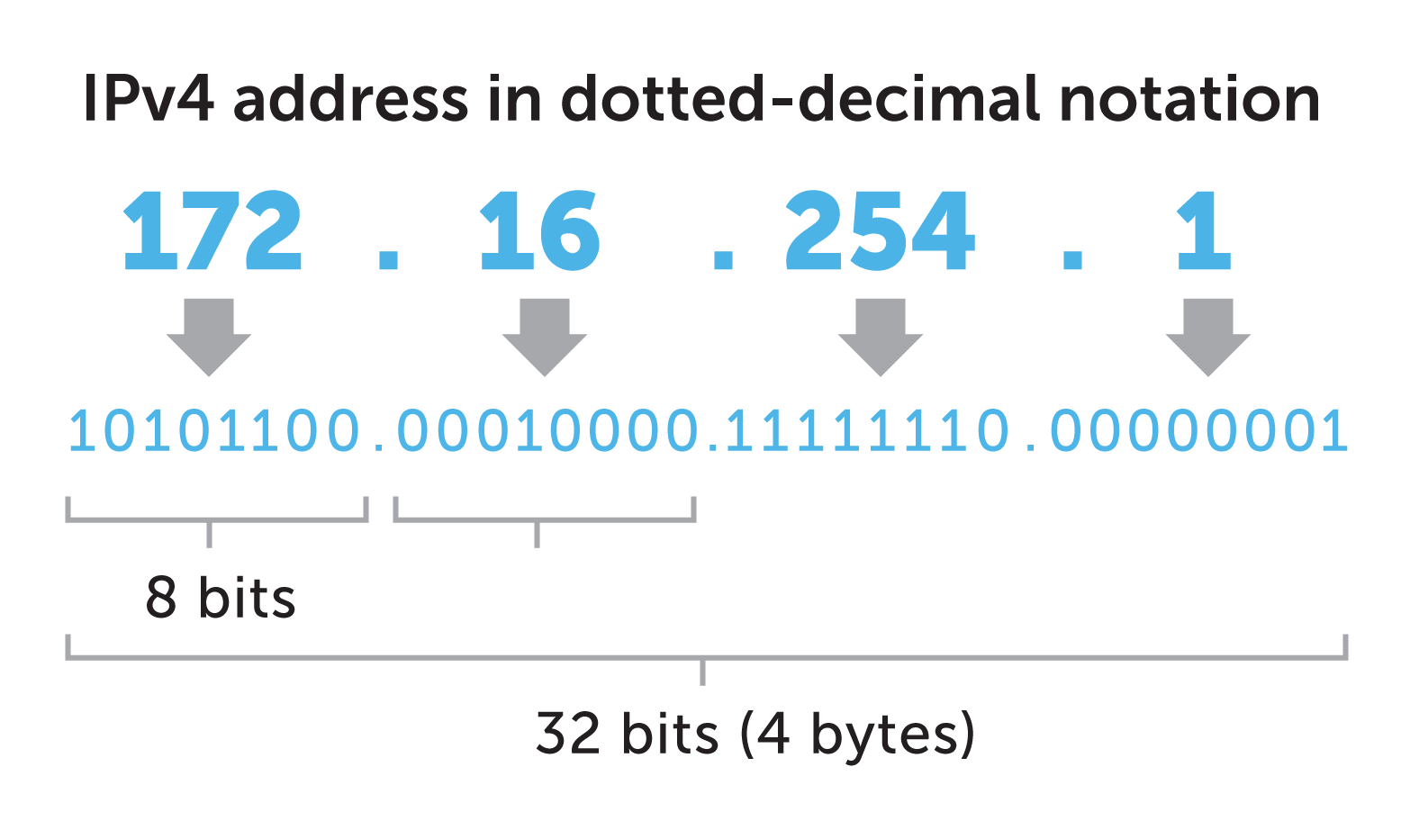
IPv4 addresses
The first version ever used on the internet
Sample IPv4 addresses: 74.125.20.225

Slide 31
IPv6 addresses
A backwards-compatible successor of IPv4 addresses
First, why do we need to adopt a new protocol for representing IP addresses?
On the 25th of November 2019, RIPE NCC made the final /22 IPv4 allocation from the last remaining addresses in the available pool and has officially run out of IPv4 addresses (Noction Report)
Sample IPv6 addresses: 2001:0db8:0000:0042:0000:8a2e:0370:7334

Slide 32
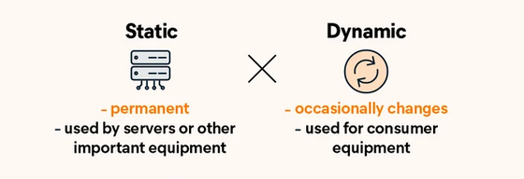
Dynamic v.s. Static IP addresses
A dynamic IP address is a temporary address for devices connected to a network that could changes over time
Switching to a different Wi-Fi network
A static IP address is an IP address that doesn't change over time
Google.com IPv4 address: 8.8.8.8

Slide 33
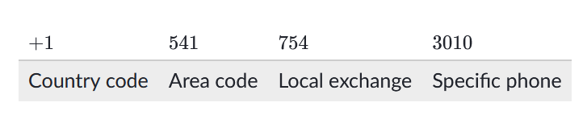
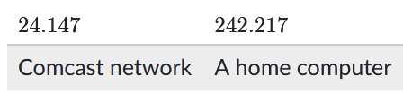
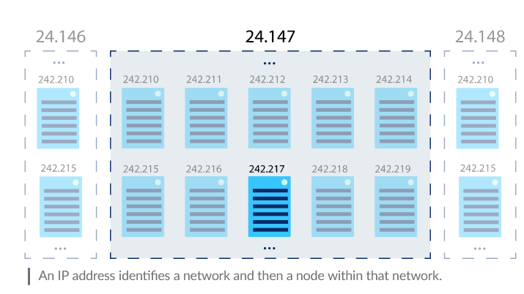
IP address hierarchy
U.S. Phone number hierarchy
IPv4 hierarchy

Slide 34
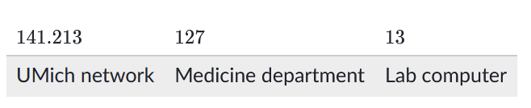
Subnetworks
Subnet: A subnet, or subnetwork, is a network inside a network. Subnets make networks more efficient. Through subnetting, network traffic can travel a shorter distance without passing through unnecessary routers to reach its destination.

Slide 35
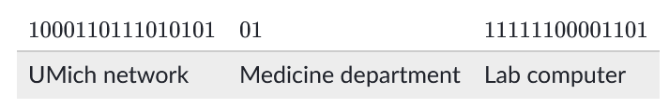
Subnets IP address assignment – in reality
=
1000110111010101 01111111 00001101

Slide 36
Quiz (10 min)

Slide 37
Quiz Q&A (3 min)

Slide 38
Review (20 min)
Definition of Computer network & computing device
Network Topology, draw any two and name one advantage and disadvantage for each topology
Definition of LAN, give one example of LAN
Definition of WAN, give one example of WAN
Physical Connections: list all three methods, the medium (e.g. sound, light) each one uses to transfer information, and the trade off of using each method
What is the unit for bit rate?
Can bit rate in a network system exceed the bandwidth of that system?
Is it possible for two devices to have the same IP address? What problem could that cause?
What is the difference between ipv4 and ipv6 addresses? What advantage does ipv6 addresses have?

Slide 39
Discussion (8 min)

Slide 40
Unit 2: The Internet
Introducing the internet
Computer networks
Addressing the internet
Routing with redundancy

Slide 41
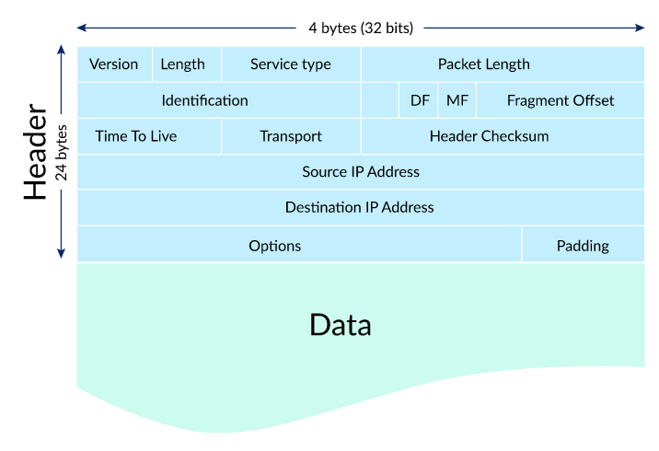
IP Packets
IP packets: IP packets is a unit of data used for transmitting data across computer networks.
Why don’t we just send the data all at once?

Slide 42
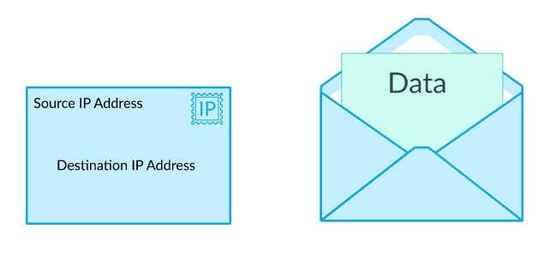
IPv4 packet structure
Header (20 or 24 bytes long) + Data (variable length)
=

Slide 43
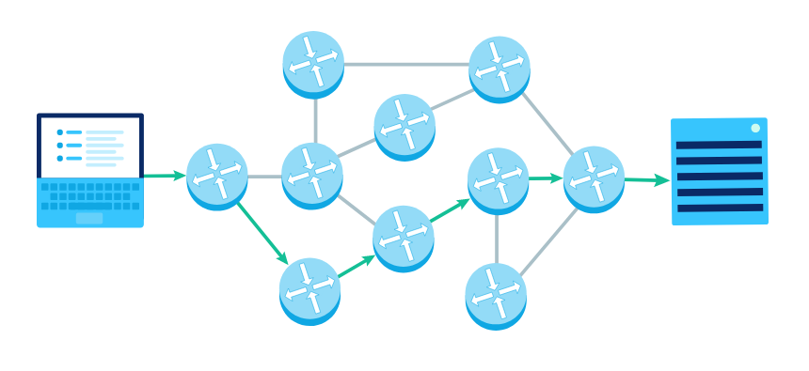
Internet Routing Protocol
The Internet Protocol (IP) is the protocol that describes how to route messages from one computer to another computer on the network.

Slide 44
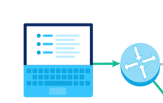
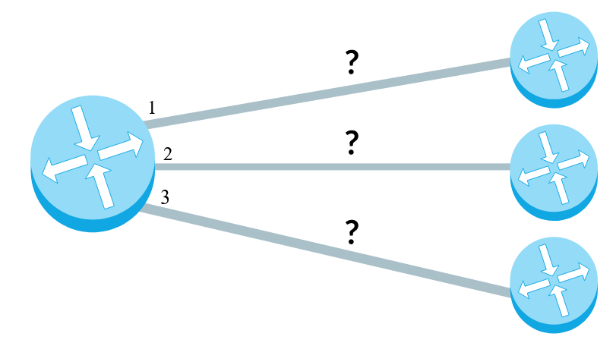
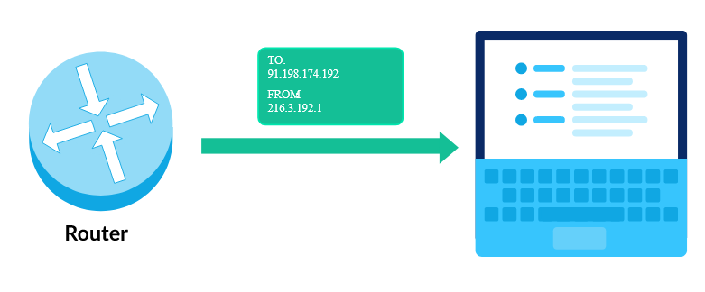
Internet Routing Protocol Big idea
Step 1: The computer sends the packet with the source and destination address to the nearest router
Step 2: The router has a forwarding table which contains IP addresses of neighboring routers that can be used to find the “best” router to forward the data
Step 3: Step 2 gets repeated until packet reaches the correct destination
Notes:
https://www.indeed.com/career-advice/career-development/routing-protocols

Slide 45
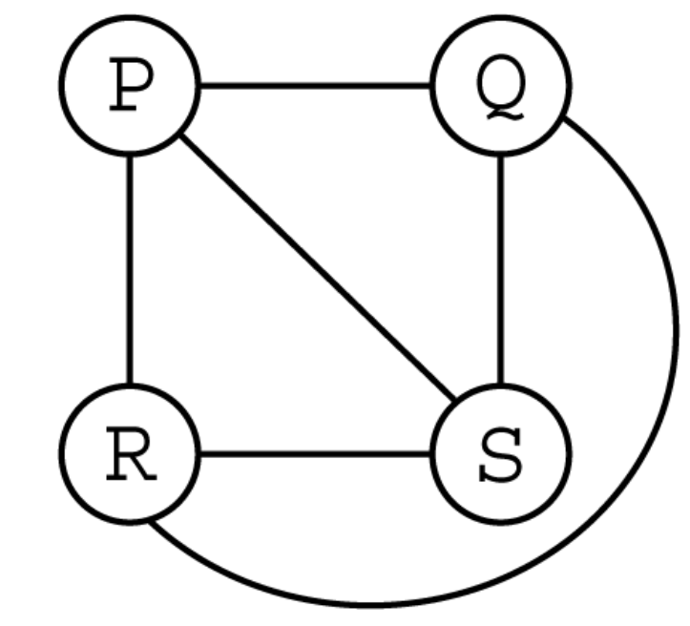
Redundancy and Fault Tolerance
A fault-tolerant system is one that can experience failure (or multiple failures) in its components, but still continue operating properly.
A single point of failure is a component in the system that will bring down the entire system if it fails.

Slide 46
Unit 2: The Internet
Introducing the internet
Computer networks
Addressing the internet
Routing with redundancy
Transporting packets

Slide 47
Problems that the IP cannot address
Differentiating between multiple messages
Packets can arrive out of order
Packets can be corrupted
Packets can be lost due to problems in the physical layer or in routers' forwarding tables.
Packets might be duplicated due to accidental retransmission of the same packet.

Slide 48
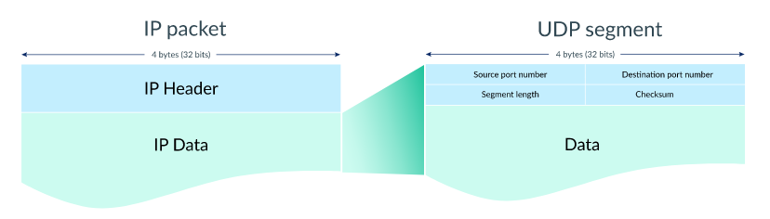
User datagram protocol (UDP)
The User Datagram Protocol (UDP) is a lightweight data transport protocol that works on top of IP. UDP provides a mechanism to detect corrupt data in packets.

Slide 49

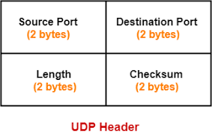
Source port number & Destination port number
The first four bytes of the UDP header store the port numbers for the source and destination.
A networked device can receive messages on different virtual ports, and the different ports help distinguish different types of network traffic.

Slide 50
Segment Length
The next two bytes of the UDP header store the length (in bytes) of the segment (including the header)

Slide 51
Checksum
The final two bytes of the UDP header is the checksum, a field that's used by the sender and receiver to check for data corruption.

Slide 52
UDP features and usage
Unreliable: when message is sent out, there is no way to tell if it arrived or not
Often used when speed is valued over accuracy, such as living streaming

Slide 53
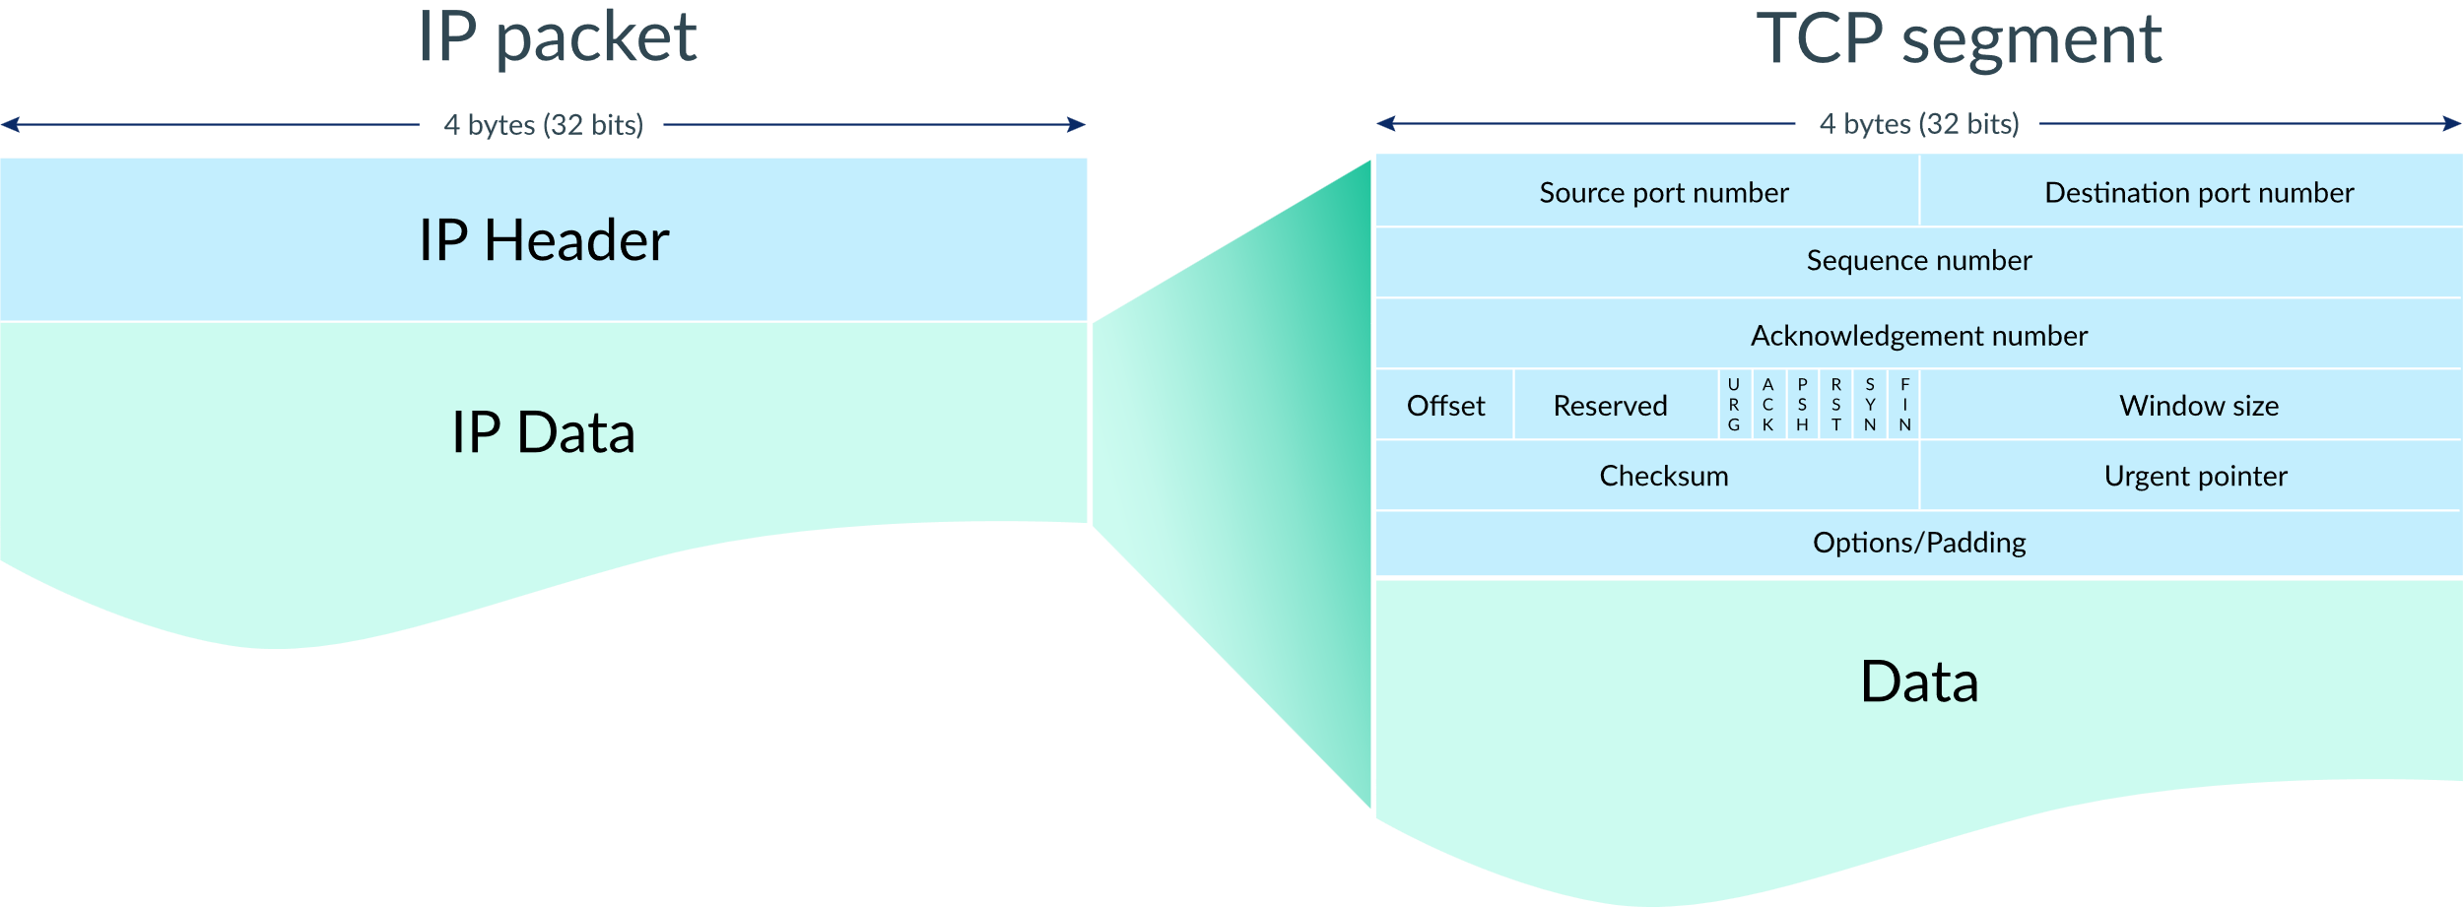
Transmission Control Protocol (TCP)
The Transmission Control Protocol (TCP) is a transport protocol that is used on top of IP to ensure reliable transmission of packets
TCP includes mechanisms to solve many of the problems that arise from packet-based messaging, such as lost packets, out of order packets, duplicate packets, and corrupted packets

Slide 54
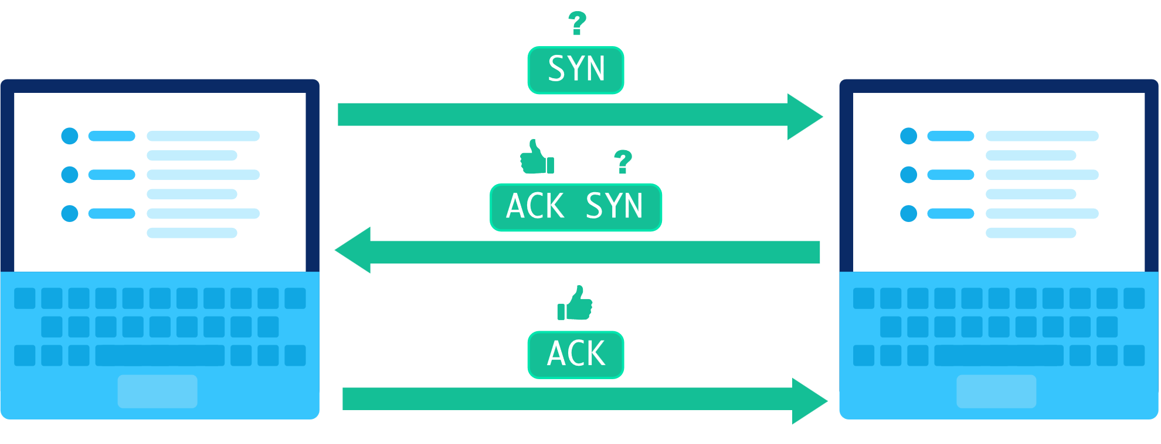
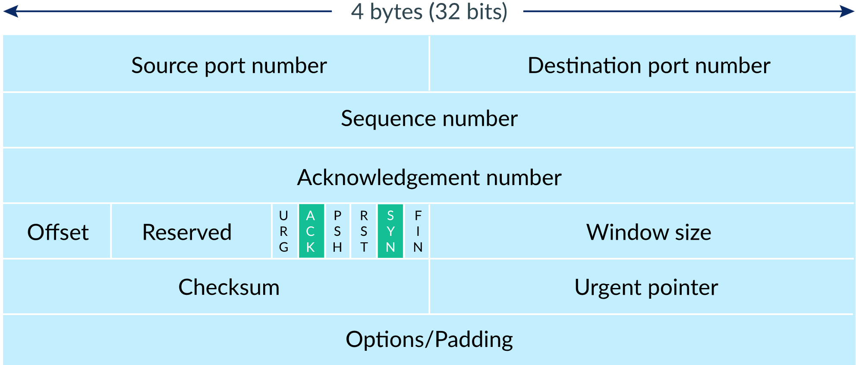
TCP/IP process
Step 1: Establish connection:
When two computers want to send data to each other over TCP, they first need to establish a connection using a three-way handshake.

Slide 55
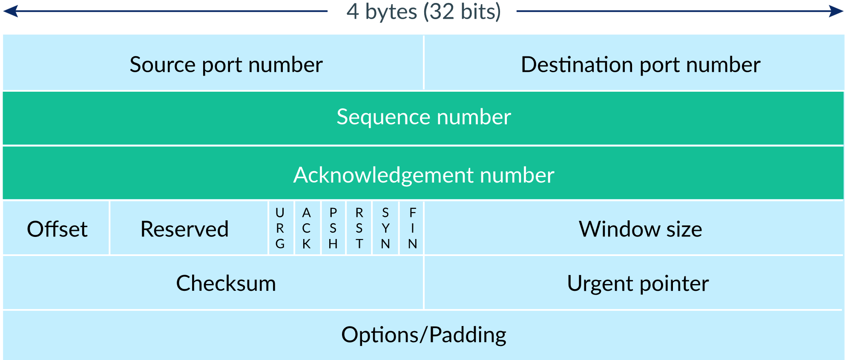
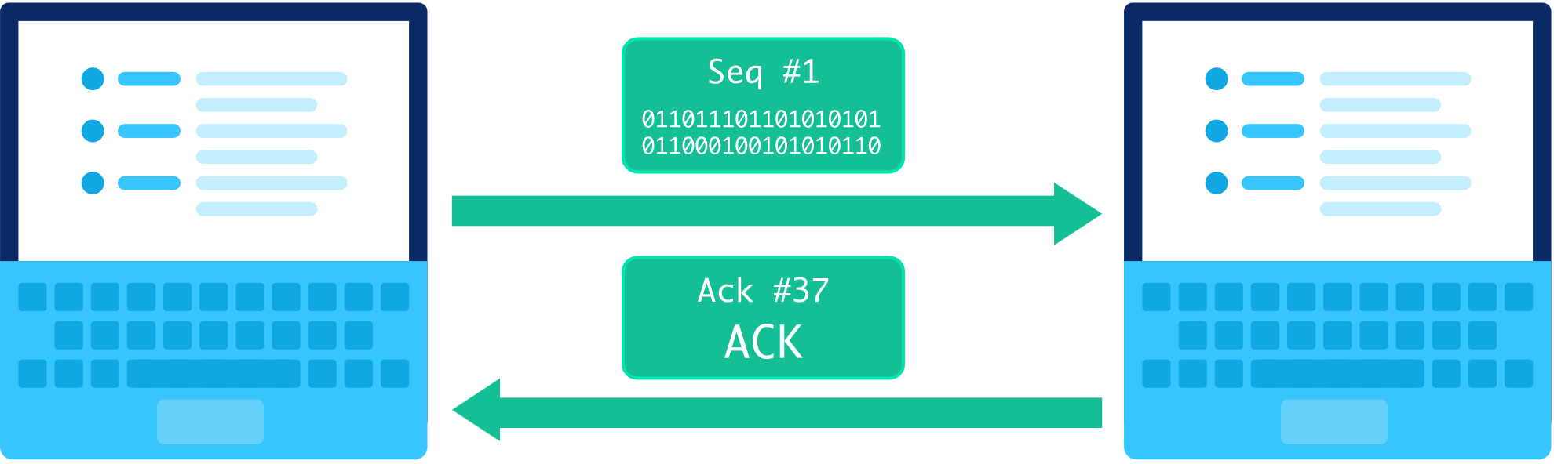
TCP/IP process
Step 2: Sending packets of data
When a packet of data is sent over TCP, the recipient must always acknowledge what they received.
The first computer sends a packet with data and a sequence number. The second computer acknowledges it by setting the ACK bit and increasing the acknowledgement number by the length of the received data.

Slide 56
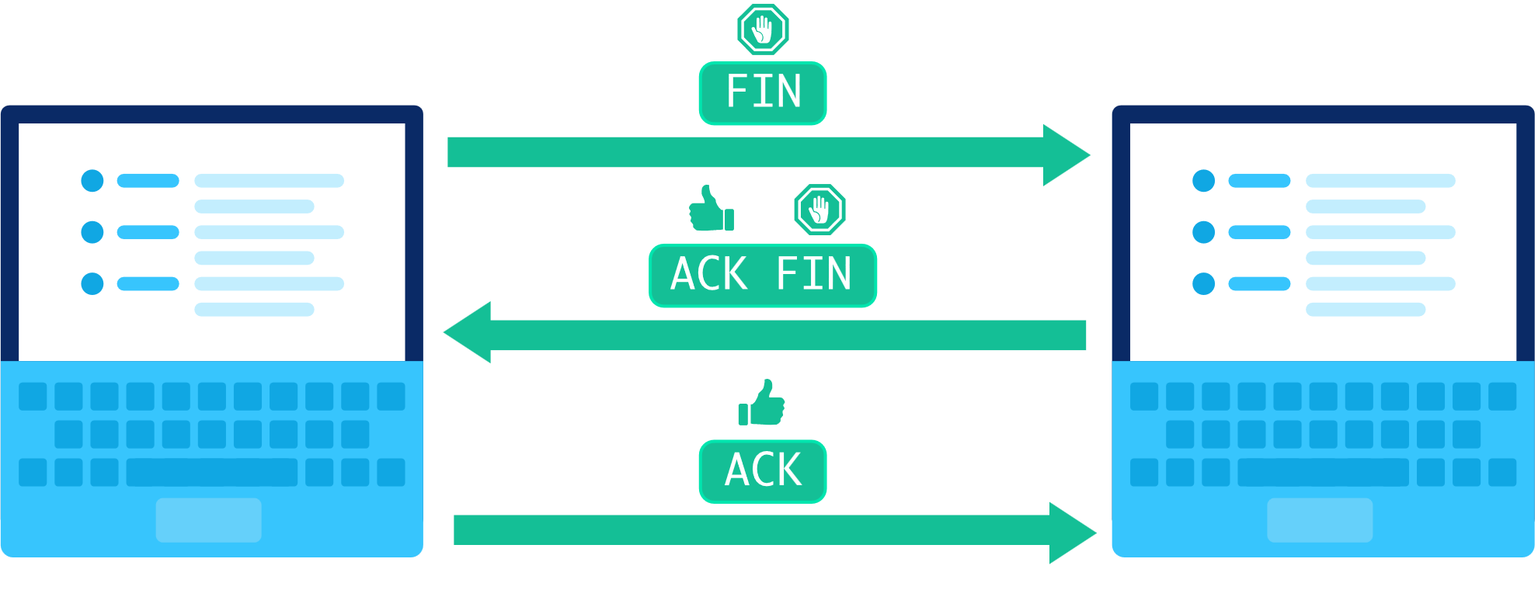
TCP/IP process
Step 3: Closing the connection
Either computer can close the connection when they no longer want to send or receive data.

Slide 57
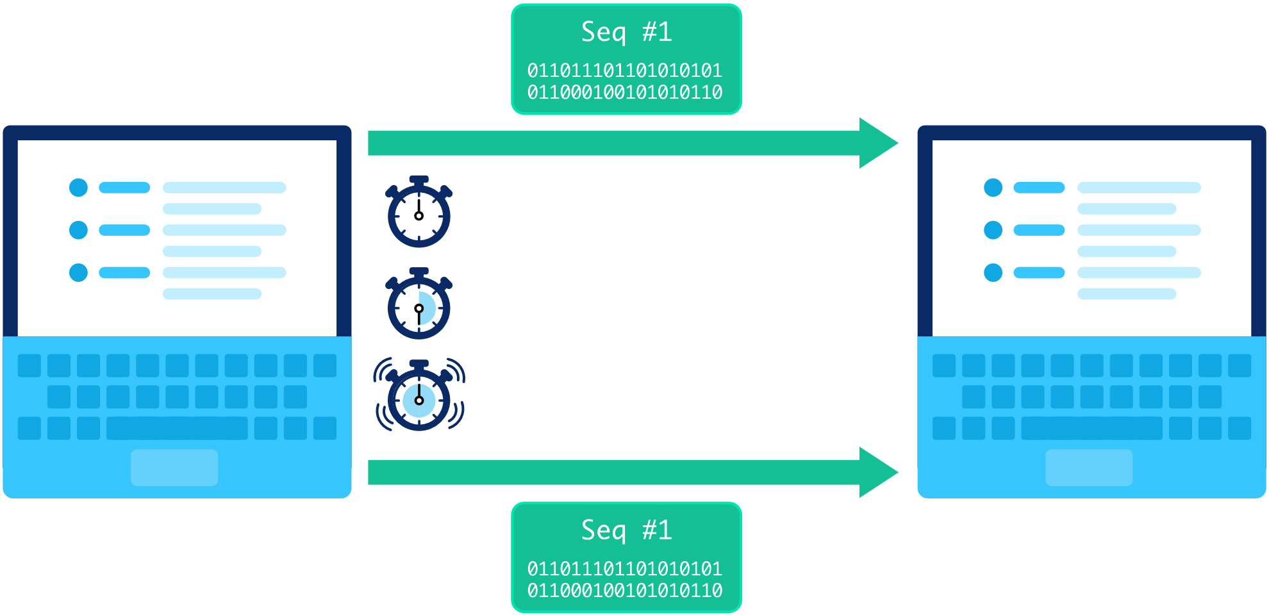
Detecting and Resending lost packets
TCP connections can detect lost packets using a timeout.
After sending off a packet, the sender starts a timer and puts the packet in a retransmission queue. If the timer runs out and the sender has not yet received an ACK from the recipient, it sends the packet again.

Slide 58
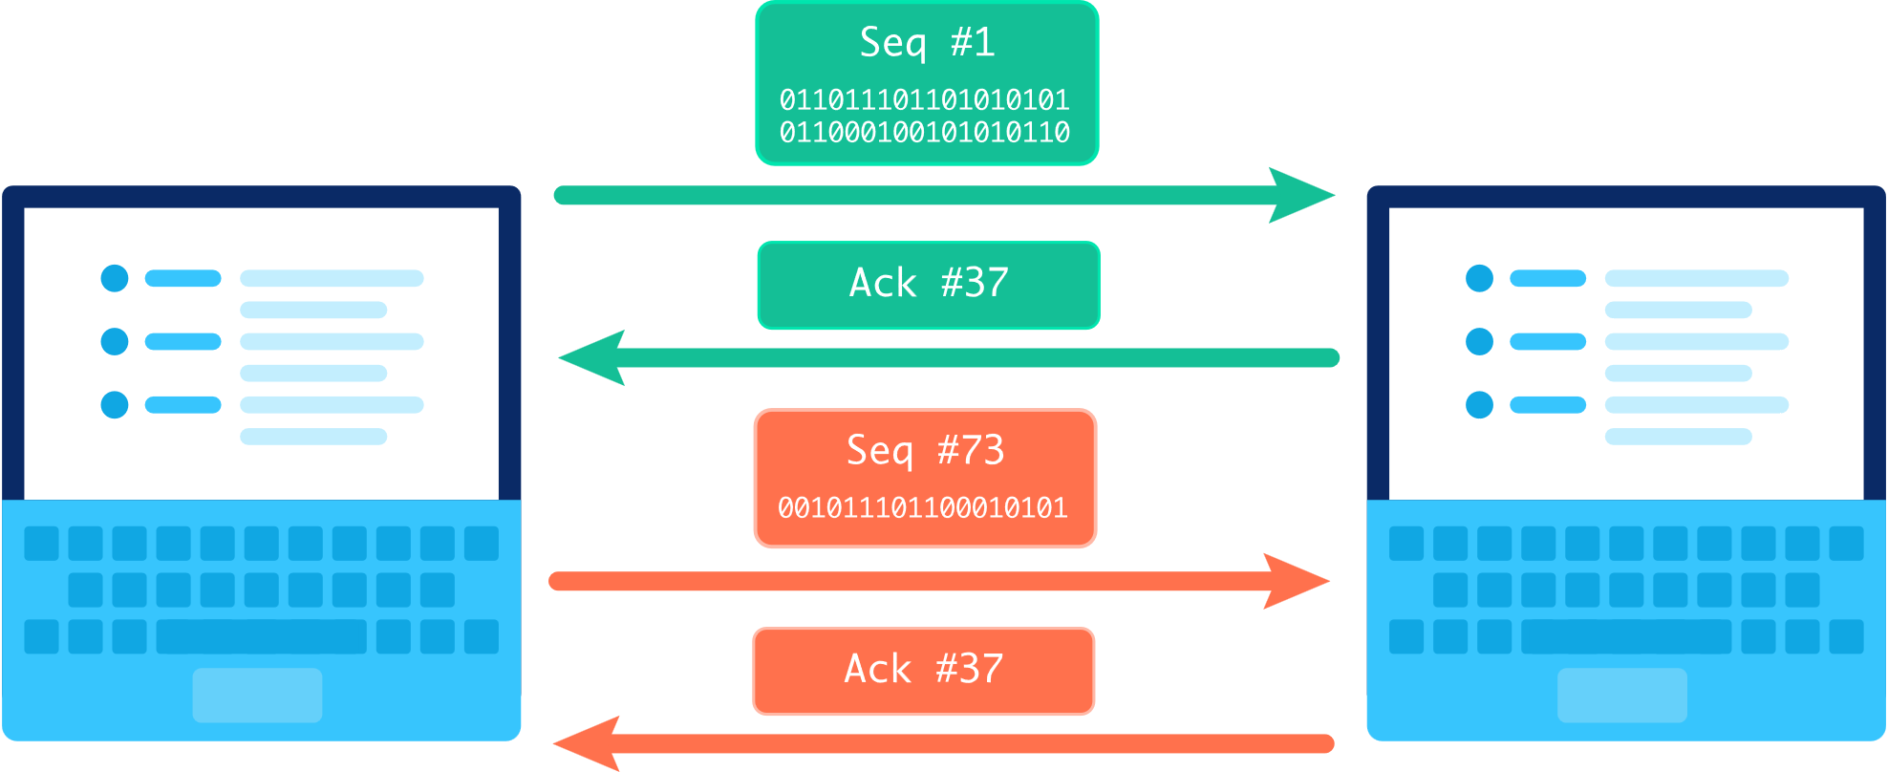
Handling out of order packets
TCP connections can detect out of order packets by using the sequence and acknowledgement numbers.
When the recipient sees a higher sequence number than what they have acknowledged so far, they know that they are missing at least one packet in between.

Slide 59
Unit 2: The Internet
Introducing the internet
Computer networks
Addressing the internet
Routing with redundancy
Transporting packets
Web Protocols

Slide 60

Overview of the Internet protocol suite

Slide 61

The World Wide Web (WWW)
The Web is a massive network of webpages, programs, and files that are accessible via URLs.
https://en.wikipedia.org/wiki/World_Wide_Web

Slide 62

Domain Name System (DNS) Protocol
A domain name is a string of text that maps to an alphanumeric IP address, used to access a website from client software. In plain English, a domain name is the text that a user types into a browser window to reach a particular website.
[third-level-domain].[second-level-domain].[top-level-domain]

Slide 63

Domain Name System (DNS) Protocol
The Domain Name System (DNS) is the phonebook of the Internet. DNS translates domain names to IP address

Slide 64
Hypertext Transfer Protocol (HTTP)
Whenever you visit a page on the web, your computer uses the Hypertext Transfer Protocol (HTTP) to download that page from another computer somewhere on the Internet.

Slide 65

Hypertext transfer protocol secure (HTTPS)
Hypertext transfer protocol secure (HTTPS) is the secure version of HTTP. HTTPS is encrypted in order to increase security of data transfer
HTTPS = HTTP + TLS
In websites without HTTPS, it is possible for Internet service providers (ISPs) or other intermediaries to inject content into webpages without the approval of the website owner.

Slide 66




The complete process of visiting a webpage on the internet
Step 1: Type the URL into a browser
Step 2: Browser sends a DNS request to the DNS resolver to map the domain name into an IP address
Step 3: Browser send a HTTP request to the web server (Host)
Step 4: The host sends back a response that contains instructions to render the page

Slide 67

Step 5: Browser renders the page

Slide 68
Unit 2: The Internet
Introducing the internet
Computer networks
Addressing the internet
Routing with redundancy
Transporting packets
Web Protocols
The internet protocol suite

Slide 69
Overview of the Internet protocol suite

Slide 70



A protocol stack
When a message is sent through the Internet, it doesn't use every protocol in the suite. It does use at least one protocol from every layer, however.

Slide 71
Unit 2: The Internet
Introducing the internet
Computer networks
Addressing the internet
Routing with redundancy
Transporting packets
Web Protocols
The internet protocol suite
Scalable systems

Slide 72

Scalable system
The Internet began its life as a network connecting universities and research centers.
Now the internet has more than 5 billion users (the world population is roughly 8.1 billion)
A scalable system is one that can continue functioning well even as it experiences higher usage

Slide 73

Internet Scalability ++
The IPv6 addressing system can uniquely address a trillion times the amount of devices currently connected to the Internet.
Routing is dynamic, so new routers can join a network at any time and help to move data packets around the Internet.

Slide 74
Internet Scalability --
Network connections have limited bandwidth
Routers have limited throughput (the amount of data they can forward per second)
Wireless routers often have a limitation in the number of devices that can be connected to them, typically up to 250 devices

Slide 75



Web application scalability
Load testing : simulating high amounts of traffic in a short period of time to see if the system buckles under the load
The spectrum of scalability: Scalable systems can handle extra usage, but their capacity varies. Some systems might only scale to handle double the current usage; other systems might scale to handle 1000x the current usage.

Slide 76
Unit 2: The Internet
Introducing the internet
Computer networks
Addressing the internet
Routing with redundancy
Transporting packets
Web Protocols
The internet protocol suite
Scalable systems
Open protocol development

Slide 77


Open protocol development
Many protocols on the internet are standardized and open
Open protocol: An open (nonproprietary) protocol is one that is not owned by any company and not limited to a particular company's products
Standardized protocol: Standardization ensures that the computing devices use the same standard for communication
Standardization

Slide 78

Proprietary protocol
A proprietary protocol is a communication protocol owned by a single organization or individual

Slide 79
Discuss with your partner the trade-offs of using open protocols versus using proprietary protocols

Slide 80
Unit 2: The Internet
Introducing the internet
Computer networks
Addressing the internet
Routing with redundancy
Transporting packets
Web Protocols
The internet protocol suite
Scalable systems
Open protocol development
The digital divide

Slide 81


The digital divide
The “digital divide” refers to differing access to computing devices and the Internet, based on socioeconomic, geographic, or demographic characteristics.
A map of school districts with 1 Mbps connections

Slide 82


The global digital divide
Global digital divide refers to the differences in internet access across countries of the world
In Norway, 96% of the population used the Internet. In Somalia, 2%
n Yemen it would take an average of 30hrs, 1 minute and 40 seconds to download a 5GB movie. In Taiwan, it would take only 8 minutes.
percentage of individuals using the Internet in each country in 2016
average speed of Internet connections in each country in 2019

Slide 83
Discuss with your partner the reasons for global digital divide, and the solution for it

Slide 84


The geographic digital divide
Within each nation—even nations with relatively high connectivity—the infrastructure of the Internet is not distributed equally.
amount of people in various US regions that lacked access to 25 Mbps broadband Internet connections in 2014

Slide 85
Classroom connectivity gap
E.g. Monterey Bay Academy
A map of school districts with 1 Mbps connections in 2019

Slide 86
Discuss with your partner the reasons for geographic digital divide and the solution for it

Slide 87

The socioeconomic divide
Even within a region that is well connected to the Internet, we still find differences in which households have access to computers and the Internet. Those differences are often due to socioeconomic factors.

Slide 88

Sample exam questions on digital divide

Slide 89
End of Chapter 2 The Internet

